Slide 1



Department of Computer Science and Engineering
Real-time crowd and violence detection
LATHIKESHWARAN.S [REGISTER NO:211421104138]
LOGESH.S [REGISTER NO:211421104145]
NAVEEN .S [REGISTER NO:211420104172]
Dr. M. KRISHNAMOORTHY M.E., Ph.D., Professor
Department of CSE
Panimalar Engineering College
Dr. R. JOSPHINELEELA, M.E, Ph.D Associate Professor
Department of CSE
Panimalar Engineering College
19-10-2023
1

Slide 2
ABSTRACT
The project uses the YOLOv8 algorithm to analyze real-time video feeds for detecting sudden increases in crowd density and violent activities.
Upon detection, the system triggers an alert sound and sends an email notification to the user, enabling quick response.
It aims to improve security and public safety in various environments, such as public gatherings, events, and surveillance zones.
By automating the monitoring process, the system reduces human error and provides more accurate detection compared to traditional methods.
The system continuously improves its accuracy by incorporating additional data and feedback, ensuring long-term effectiveness.

Slide 3
INTRODUCTION
This project focuses on enhancing public safety by developing a real-time crowd and violence detection system using advanced machine learning techniques, specifically YOLOv8.
The system is designed to automatically detect sudden changes in crowd density and violent activities in various environments, such as public events and surveillance zones.
By leveraging YOLOv8’s high accuracy and efficiency, the system can provide real-time alerts, helping security personnel respond quickly to potential threats.
Traditional surveillance methods often rely on human monitoring, which can be time-consuming and prone to errors, making automated systems a crucial improvement.
This project aims to fill the gap in current security solutions by integrating real-time detection with automated alerts, improving both safety and response times in high-risk areas.

Slide 4
Objective of the Project
Develop a Real-Time Detection System – Implement YOLOv8 for crowd and violence detection.
Enhance Public Safety – Enable rapid response through automated alerts.
Utilize Advanced Object Detection – Ensure high accuracy and speed in detecting anomalies.
Integrate a User-Friendly Interface – Simplify monitoring and response actions.
Automate Alert Mechanisms – Provide instant alerts through sound and email notifications.
Ensure System Scalability and Reliability – Adapt to different surveillance settings.
Improve Model Accuracy Over Time – Enhance detection with continuous learning.

Slide 5
LITERATURE SURVEY
Title | Authors | Description | Advantages | Disadvantages
Real-Time Violence and Weapon Detection and Alert System (2024) | More, P., Patil, S., & Pattanshetti, T. | This system focuses on real-time detection of violence and weaponry through surveillance. It employs advanced machine learning models to identify violent activities and weapons in crowded environments, triggering alerts for quick response. | Provides instant alerts for security personnel, improving response speed during emergencies. | Requires significant computational resources to handle real-time video feeds efficiently.

Slide 6
LITERATURE SURVEY
Title | Authors | Description | Advantages | Disadvantages
Proactive Headcount and Suspicious Activity Detection Using YOLOv8 (2023) | Sudharson, D., Srinithi, J., Akshara, S., Abhirami, K., Sriharshitha, P., & Priyanka, K. | Utilizes YOLOv8 for headcount and suspicious activity detection in crowded areas. The system automatically counts people and detects irregular behavior to improve crowd management and security. | Ensures accurate crowd counting and activity monitoring, enhancing public safety in crowded spaces. | Accuracy can be affected by poor video quality or large crowd density.

Slide 7
LITERATURE SURVEY
Title | Authors | Description | Advantages | Disadvantages
YOLOv8-Based Person Detection, Distance Monitoring, Speech Alerts, and Weapon Identification with Email Notifications (2024) | Jyothsna, V., Alle, C., Kurnutala, R., Ganesh, K. N., KushalKarthik, K. R., & Pydala, B. | This system uses YOLOv8 for detecting individuals, monitoring distances, identifying weapons, and providing speech alerts and email notifications to security personnel. | Combines person detection with distance monitoring and weapon detection for comprehensive security. | Potential false positives in crowded areas leading to unnecessary alerts.

Slide 8
LITERATURE SURVEY
Title | Authors | Description | Advantages | Disadvantages
Human Crowd Detection for City-Wide Surveillance (2020) | Singh, D. K., Paroothi, S., Rusia, M. K., & Ansari, M. A. | Presents a method for detecting human crowds in city-wide surveillance systems, helping authorities manage public events and potential threats by recognizing crowd patterns. | Effective in real-time monitoring of crowd behavior in city-wide surveillance systems. | Limited in dense scenarios where distinguishing between individuals and large groups is challenging.

Slide 9
LITERATURE SURVEY
Title | Authors | Description | Advantages | Disadvantages
An Enhanced Framework for Real-Time Dense Crowd Abnormal Behavior Detection Using YOLOv8 (2024) | Nasir, R., Jalil, Z., Nasir, M., Noor, U., Ashraf, M., & Saleem, S. | Uses YOLOv8 to detect abnormal behaviors in dense crowds, sending alerts for suspicious activities in real-time to enhance security. | Provides early detection of potential threats in dense crowds, improving security response times. | The system may struggle in extremely dense environments where distinguishing actions is difficult.

Slide 10
LITERATURE SURVEY
Title | Authors | Description | Advantages | Disadvantages
Efficient Aggressive Behaviour Detection and Alert System Employing Deep Learning Techniques (2024) | Inbavalli, A., Jarshini, T., & Muralikrishnaa, M. | Discusses an aggressive behavior detection system using deep learning models that identifies aggressive actions through video analysis and sends real-time alerts. | Effectively detects aggressive behavior, enabling timely security intervention. | May require high computational power, especially with multiple camera feeds.

Slide 11
LITERATURE SURVEY
Title | Authors | Description | Advantages | Disadvantages
Violence-YOLO: Enhanced GELAN Algorithm for Violence Detection (2024) | Xu, W., Zhu, D., Deng, R., Yung, K., & Ip, A. W. | Introduces Violence-YOLO, an enhanced GELAN algorithm for improving violence detection in public spaces, optimized for high-accuracy detection of violent confrontations. | Offers higher detection accuracy for violence in diverse environments, improving response time. | Detection may be delayed with extreme or rapid violence actions.

Slide 12
Problem Statement
Traditional surveillance relies on human operators, leading to fatigue, missed events, and scalability issues in large public spaces. Existing AI-based solutions often have high false positive rates, causing unnecessary alerts and reducing reliability. Conventional systems are also passive, reviewing CCTV footage post-incident rather than enabling real-time intervention. Additionally, many surveillance systems struggle with processing high-resolution video efficiently, causing delays in threat detection. This project aims to overcome these challenges by developing a real-time AI-powered crowd and violence detection system using YOLOv8, ensuring fast analysis, low false positives, and immediate alerts for enhanced public safety.

Slide 13
PROPOSED SYSTEM
The system uses YOLOv8 for real-time detection of sudden increases in crowd density and violent activities.
It will be trained with a diverse dataset of images and videos to improve detection accuracy and adaptability.
Upon detecting an event, the system will trigger an alert sound and send email notifications to the relevant authorities.
A user-friendly interface will be developed to monitor, manage, and control alerts and notifications easily.
Continuous improvements will be made to the model by incorporating additional data and feedback to enhance its effectiveness.

Slide 14
Software / Hardware used
Hardware Requirements :
System Device : Mobile or Computer
Processor : Intel Core i7 / AMD Ryzen or Higher
RAM : 16GB or Higher (Both mobile and computer)
Computer Storage : 512 GB SSD or Higher
Mobile Storage : 64 GB or Higher
Camera : 1080p Full HD and Minimum 30FPS
Software Requirements :
Mobile OS : Android version 10
Computer OS : Windows 10 or Higher
Languages : Python 3.8+, Flask
Libraries : Pandas, Numpy, TensorFlow or PyTorch, OpenCV,Matplotlib and . Seaborn.

Slide 15
EXISTING SYSTEM
Manual Monitoring: Current systems require human monitoring of surveillance feeds, which is time-consuming, inefficient, and prone to human errors.
Limited Detection Capabilities: Existing automated systems may not accurately detect sudden crowd increases or violent activities, leading to potential security gaps.
Lack of Real-Time Alerts: Many existing systems do not provide real-time alerts, making it difficult to respond to incidents as they happen and delaying security intervention.
Low Integration with Machine Learning: Traditional systems do not effectively utilize advanced machine learning models, limiting the accuracy and adaptability of threat detection.
Reactive Approach: Current surveillance systems are often passive, meaning they only detect issues after they occur rather than providing proactive solutions for early intervention.

Slide 16
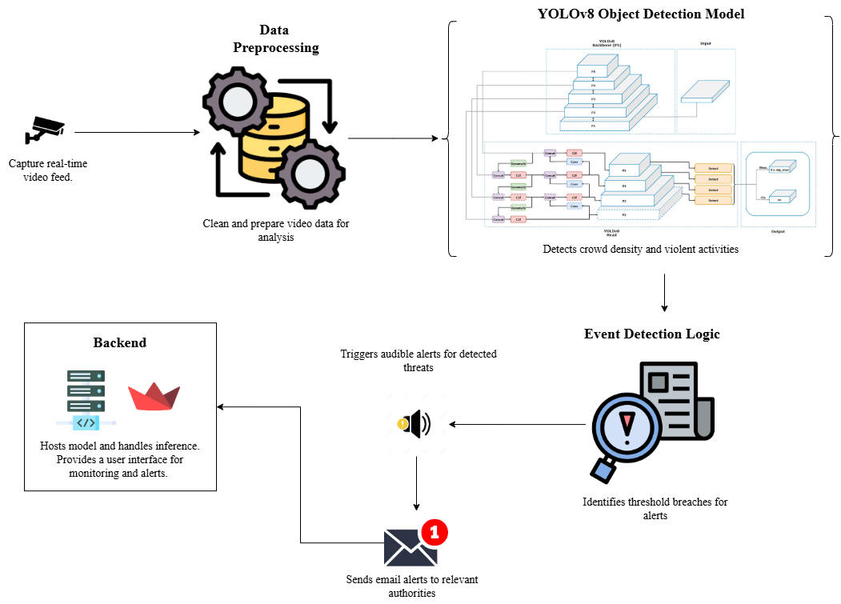
ARCHITECTURE DIAGRAM

Slide 17
Data Collection and Preprocessing Process (EDA)
In this module, the goal is to source datasets relevant to the project from open-source platforms such as Kaggle and Roboflow. We will then perform extensive data cleaning by removing unnecessary rows, columns, or irrelevant data points to ensure that we have a refined and usable dataset. Following this, we will apply various preprocessing techniques, including normalizing data, handling missing values, and encoding categorical variables (if any). This prepares the data for further analysis and model training.

Slide 18
Model Loading
In this module, we will train the model using the cleaned and preprocessed dataset. This involves selecting appropriate algorithms and training the model to make accurate predictions. The model will be built using YOLOv8 or any other suitable algorithm for real-time crowd and violence detection. After training, we will evaluate the model’s performance using different metrics (such as precision, recall, and accuracy) to ensure it works well for the intended use case.

Slide 19
Backend and Streamlit Web App
This module will focus on integrating the trained model with the backend and developing the frontend using Streamlit, a simple and fast framework for building web apps. The backend will handle the model’s predictions, while the frontend will allow users to input data, interact with the system, and view predictions in real-time. The web app will provide a user-friendly interface to manage alerts, visualize the analysis, and make the system accessible to end-users such as security personnel or administrators.

Slide 20
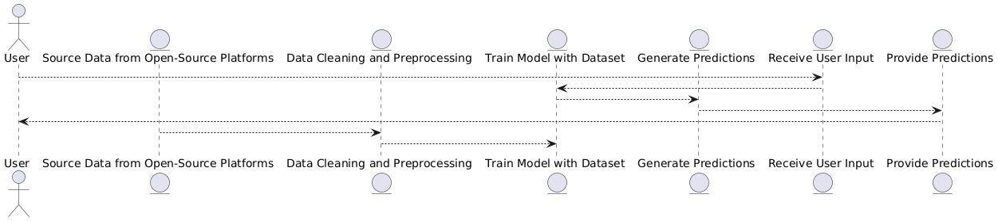
DFD-0

Slide 21
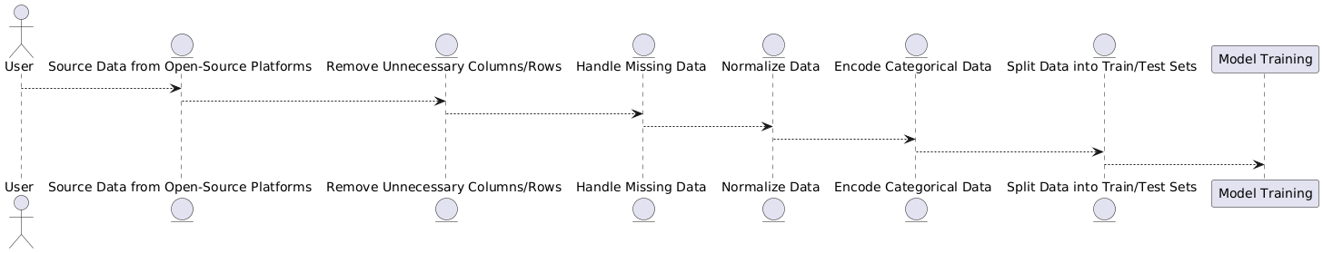
DFD-1 (Data Collection and Preprocessing Process (EDA))

Slide 22
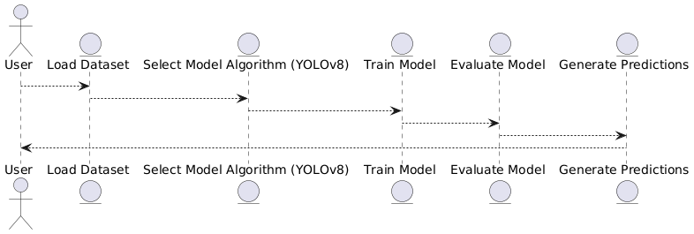
DFD-2 (Model Loading)

Slide 23
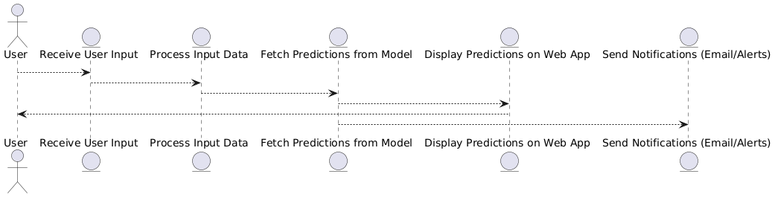
DFD-3 (Backend and Streamlit Web App)

Slide 24
Module Description
1. Data Collection and Preprocessing (EDA)
Objective: Gather and prepare high-quality datasets for training the YOLOv8 model.
Key Tasks:
Source datasets from open-source platforms like Kaggle and Roboflow.
Perform data cleaning (remove irrelevant rows/columns, handle missing values).
Apply preprocessing techniques: normalization, resizing images/videos, and encoding (if needed).
Output: Cleaned and annotated dataset ready for model training.
2. Model Training (YOLOv8 Integration)
Objective: Train a robust object detection model to identify crowd density changes and violent activities.
Key Tasks:
Implement YOLOv8 algorithm for real-time detection.
Train the model using the preprocessed dataset.
Optimize hyperparameters for accuracy and speed.
Evaluate performance metrics (precision, recall, F1-score).
Output: Trained YOLOv8 model with high detection accuracy.

Slide 25
Module Description
3. Real-Time Detection and Alert System
Objective: Monitor live video feeds and trigger alerts for anomalies.
Key Tasks:
Process real-time video streams (e.g., CCTV feeds) using OpenCV.
Detect sudden crowd surges or violent actions (e.g., fights, weapons).
Trigger immediate alerts (sound notifications, email alerts to authorities).
Output: Real-time threat detection with automated alerts.
4. Backend and Streamlit Web App
Objective: Provide a user-friendly interface for system interaction.
Key Tasks:
Develop backend logic to handle model predictions and data flow.
Build a frontend using Streamlit for live monitoring and alert management.
Enable features like threat visualization, alert logs, and manual override.
Output: Interactive dashboard for security personnel.

Slide 26
Module Description
5. Continuous Improvement Module
Objective: Enhance model accuracy over time.
Key Tasks:
Incorporate new data and user feedback into retraining cycles.
Fine-tune the model to adapt to emerging threats.
Output: Self-improving detection system.
Key Features Highlighted in Modules
Automation: Reduces human error in surveillance.
Scalability: Adaptable to various environments (public events, surveillance zones).
Proactive Alerts: Email/sound notifications enable rapid response.
User-Friendly: Streamlit interface simplifies operation for non-technical users.

Slide 27
Testing /Performance Evaluation / Results
Category | Metric | Result
Model Performance | Accuracy | 91.2%
 | Precision | 89.5%
 | Recall | 90.3%
 | F1-score | 89.9%
 | False Positives | 6.5%
 | False Negatives | 5.2%
Speed Metrics | Inference Speed | 30 FPS
 | Alert Trigger Time | 2.1 seconds
Data Processing | Preprocessing | Normalization, augmentation, missing value handling
Training | Model | YOLOv8 (compared with YOLOv5, Faster R-CNN)
Testing Environment | Test Data | CCTV footage, real-world crowded environments
 | Test Conditions | Various lighting and crowd conditions
Dataset | Source | Kaggle, Roboflow (50,000 images)
Challenges | Identified Issues | False positives, occlusions
Next Steps | Recommendations | Further fine-tuning, dataset expansion

Slide 28
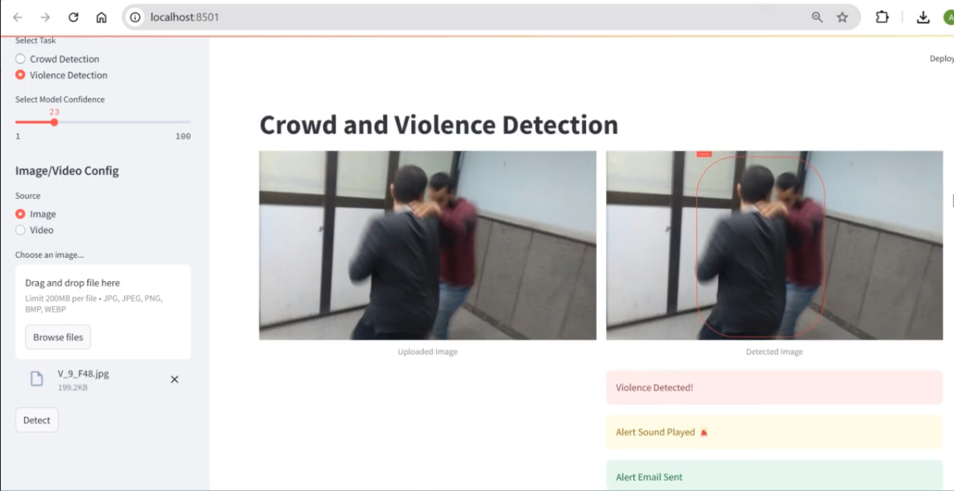
SCREENSHOTS

Slide 29
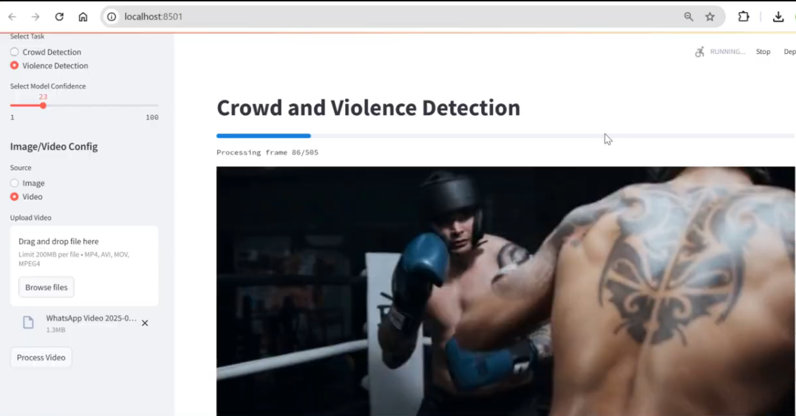
SCREENSHOTS

Slide 30
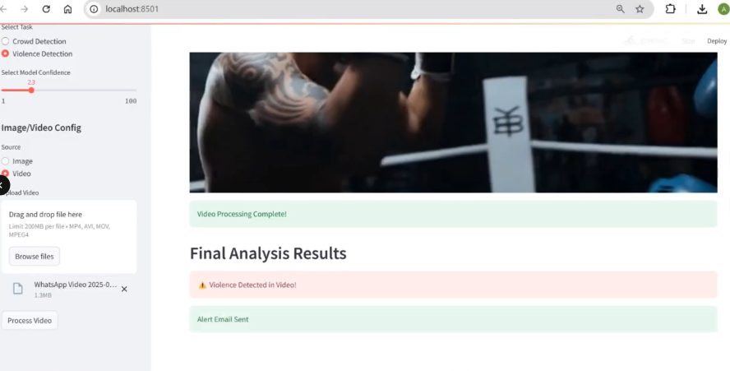
SCREENSHOTS

Slide 31
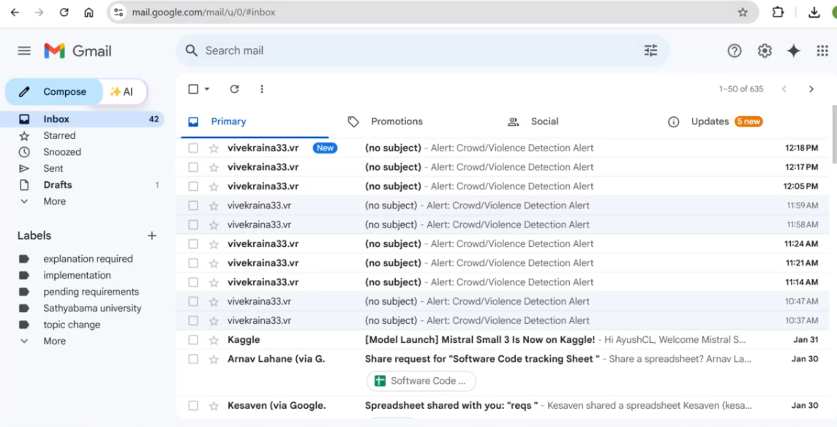
SCREENSHOTS

Slide 32
CONCLUSION
The project successfully implements a real-time crowd and violence detection system using the YOLOv8 algorithm, enabling accurate monitoring of public areas for security threats
By automating data collection, preprocessing, and model training, the system ensures efficiency and reduces human errors in surveillance, making it a valuable tool for enhancing public safety.
The integration of a Streamlit web app provides a user-friendly interface for easy interaction with the system, allowing security personnel to quickly respond to potential threats
Real-time alerts and notifications, including email and sound alerts, help improve response times, making the system proactive in preventing incidents rather than simply reacting to them.
Continuous model updates and feedback incorporation ensure that the system will keep evolving, improving its detection capabilities over time and adapting to new types of threats.

Slide 33
REFERENCES
More, P., Patil, S., & Pattanshetti, T. (2024). Real time Violence and Weapon detection and Alert System.
Sudharson, D., Srinithi, J., Akshara, S., Abhirami, K., Sriharshitha, P., & Priyanka, K. (2023). Proactive Headcount and Suspicious Activity Detection using YOLOv8. Procedia Computer Science, 230, 61-69.
Jyothsna, V., Alle, C., Kurnutala, R., Ganesh, K. N., KushalKarthik, K. R., & Pydala, B. (2024, April). YOLOv8-Based Person Detection, Distance Monitoring, Speech Alerts, and Weapon Identification with Email Notifications. In 2024 International Conference on Expert Clouds and Applications (ICOECA) (pp. 288-296). IEEE.
Singh, D. K., Paroothi, S., Rusia, M. K., & Ansari, M. A. (2020). Human crowd detection for city wide surveillance. Procedia Computer Science, 171, 350-359.
Nasir, R., Jalil, Z., Nasir, M., Noor, U., Ashraf, M., & Saleem, S. (2024). An Enhanced Framework for Real-Time Dense Crowd Abnormal Behavior Detection Using YOLOv8. Authorea Preprints.
Inbavalli, A., Jarshini, T., & Muralikrishnaa, M. (2024, March). Efficient Aggressive Behaviour Detection And Alert System Employing Deep Learning Techniques. In 2024 International Conference on Automation and Computation (AUTOCOM) (pp. 404-410). IEEE.
Xu, W., Zhu, D., Deng, R., Yung, K., & Ip, A. W. (2024). Violence-YOLO: Enhanced GELAN Algorithm for Violence Detection. Applied Sciences, 14(15), 6712.

Slide 34
THANK YOU

